Slide 1

Intro to CS

Slide 2
Homework
Review:

Slide 3
Javascript
More succinct
More powerful
More readable

Slide 4
Javascript Variables
var name = (value);
Examples:
var name = “Adhiv”;
var age = 18;
var instructors = [ “Matthew”, “Adhiv”, “Will” ];

Slide 5
Javascript Functions
functionName(input1, input2, …)
Examples:
var name = prompt(“What’s your name?”);
write(“Your name is “ + name);

Slide 6
Javascript If
prompt "What is your name?" -> name
eq name "Matthew" -> is-matthew
jump-if is-matthew #good
jump #bad
#good:
write "Welcome Matthew!"
jump #end
#bad:
write "You're not Matthew!"
jump #end
#end
var name = prompt("What is your name?");
if (name == “Matthew”) {
write(“Welcome Matthew!”);
} else {
write(“You’re not Matthew!”);
}

Slide 7
Javascript Loops
#start:
prompt "What is your name?" -> name
eq name "Matthew" -> is-matthew
jump-if is-matthew #good
jump #bad
#good:
write "Welcome Matthew!"
jump #end
#bad:
write "You're not Matthew!"
jump #end
#end:
jump #start
while (true) {
var name = prompt("What is your name?");
if (name == “Matthew”) {
write(“Welcome Matthew!”);
} else {
write(“You’re not Matthew!”);
}
}

Slide 8
Javascript Loops - While
var x = 0;
while (x < 5) {
write(x);
x = x + 1;
}
0
1
2
3
4

Slide 9
Javascript Loops - While
for (var x = 0; x < 5; x = x + 1)
write(x);
x = x + 1;
}
0
1
2
3
4

Slide 10
Homework
Javascript:

Slide 11
Hangman!
Preview:

Slide 12
Four Steps When Programming:
Think
Write
Code
Test

Slide 13
#1 - Think
What does this program need to do?
Test sets

Slide 14
Hangman test sets
Discuss:

Slide 15
#2 - Write
Pseudo-code
Max(a, b):
Is a > b? Return a
Otherwise? Return b

Slide 16
Hangman pseudo-code
Discuss:

Slide 17
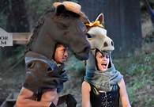
#3 - Code
Computer reads code line-by-line
Each line tells it to do something different
Not always a “right way”
(But some are more right than others)

Slide 18
Hangman code
Write:

Slide 19
Hangman!
Celebrate:

Slide 20
Break
Enjoy:

Slide 21
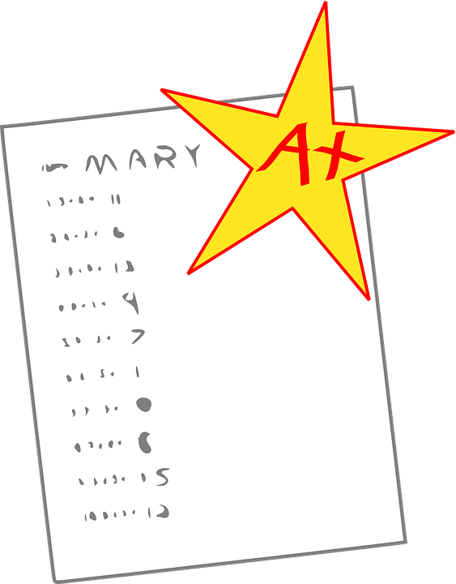
#4 - Test
Bzzrp...
Back to test sets from #1!

Slide 22
Hangman app!
Test:

Slide 23
Homework
Do your best to extend Hangman somehow
“Leg, leg, body, arm, arm, neck, head”
Hints when you get close
And/Or - learn something new about Javascript and write a program with it!
w3schools.com
Doesn’t have to work - just try!

